Slide 1

StarSail Games

Slide 2
Considerations
How many deliverables can we effectively commit to?
The more tiers and deliverables that need to be maintained, the higher the work-load
Based on “Market Research”, the most popular & profitable items to have are encounters & adventures

Slide 3
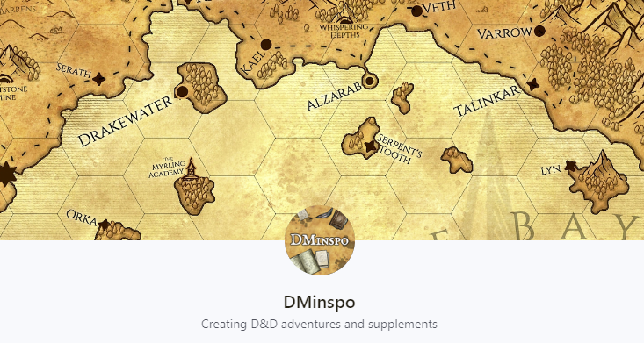
Join The Order of the Owlbear to access all of the following exclusive benefits:
Weekly encounters. Every week, Patrons get a new pre-written encounter, perfect for a traveling D&D party. These downloadable encounters include maps, monsters, and everything needed to run them.
Monthly adventures. Every month, Patrons get a fully pre-written adventure, with enough content to cover multiple sessions. These downloadable adventures include maps, monsters, and detailed settings.
Voting power. Patrons can vote for video topics, exclusive encounters, and more.
Weekly D&D encounters
Monthly D&D adventures
Patron-only voting power
Patron-only posts and messages
Only Tier: $3/Month
626 Patrons and $1,195/month
Straightforward and effective deliverables
No Custom Stat-Blocks or Art
This Patreon page has seen fast, consistent growth
Very large Tik Tok following (50k +)
In my opinion, the adventure should be under a separate $5/month tier

Slide 4
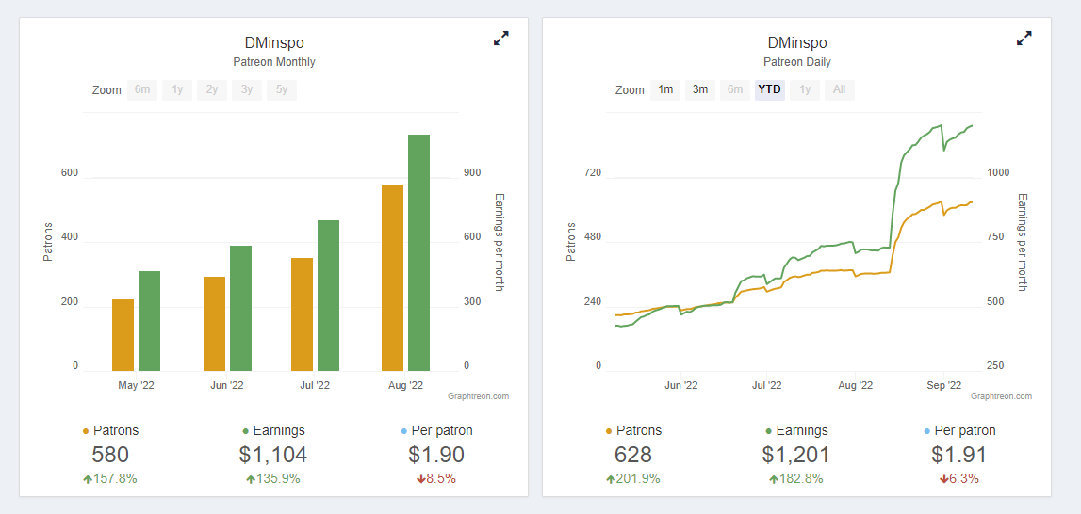

Slide 5
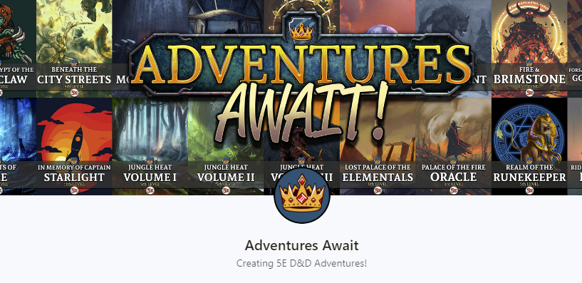
Copper Tier ($5/month)
You get access to ONE EXCLUSIVE monthly adventure.
You get access to my monthly content polls which decide what goes into my adventures!
Silver Tier ($7/month)
You get access to TWO EXCLUSIVE monthly adventures.
Gold Tier ($9/month)
You get access to THREE EXCLUSIVE monthly adventures.
Patrons: 441 & Income: $2,505/month
Pricing is simple and straightforward
No custom art or monster stat blocks
Early COVID Creator – this is his full time job now
Has Kickstarter income as well

Slide 6
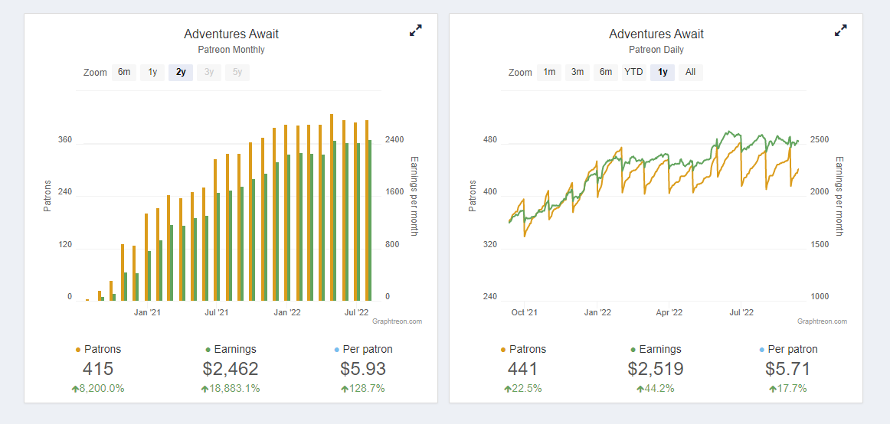

Slide 7
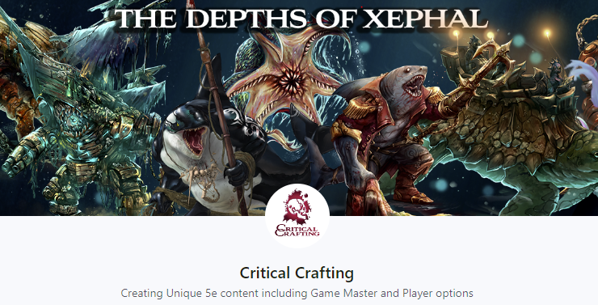
Adventurer Tier ($3/month)
The Adventurer tier includes - Access to a monthly PDF of the spells and magic items for that release
Access to a PDF of printable spell and magic item cards
Access to the backlog of all previous spell and magic item PDFs.
Acolyte Tier ($7/month)
Access to a monthly PDF of original 5e stat blocks
Access to a monthly PDF of the spells and magic items for that release
Access to a PDF of printable spell and magic item cards
Access to the backlog of all previous stat block, spell, and magic item PDFs
This tier includes all of the previous tier's benefits PLUS!
Patrons: 130 & Income: $907/month
Interesting Custom Art & Stats
Deliverables are similar to what we do now

Slide 8
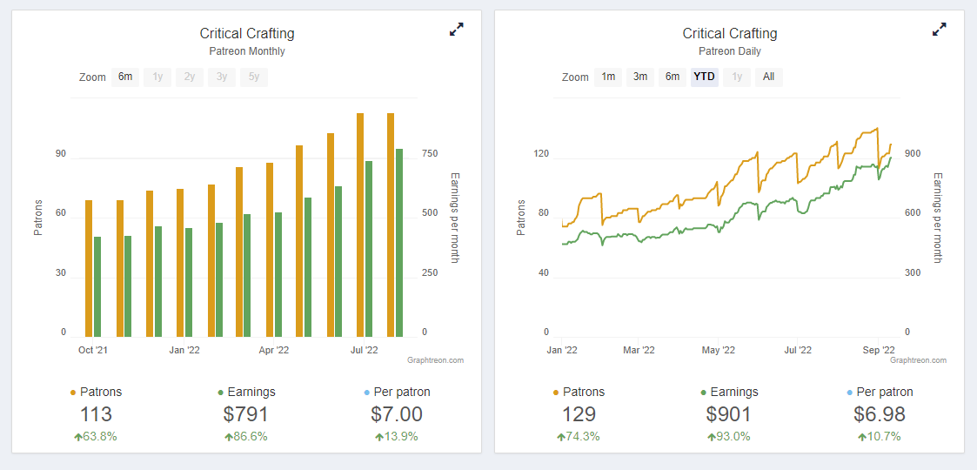

Slide 9
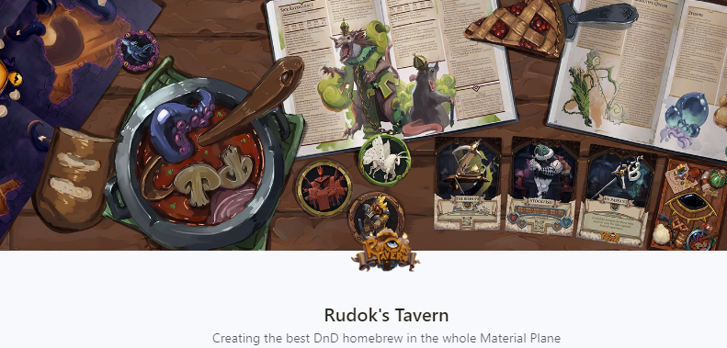
Patrons: 240
Income: $992/Month

Slide 10
Rudok’s Tavern
Adventurer’s Guild ($2/Month)
Daily Homebrew!
Monster Tokens
Access to Layered Art, and non-Watermarked illustrations all in high-res all beautiful
Rudok's Workshop, every Thursday on our discord, help with balancing and creation of your own homebrew ideas.
Rudok's Archives: All of our homebrew, (over 200 Items and Monsters)
Anthology collection of all our stories and lore
Right to vote on exclusive polls
Our gratitude
Hoarder’s Syndicate
All previous Tier Rewards
Inventory [Beautiful PDF Compendium of all our Items]
Homebrewery Discord channel for your own homebrew ideas and suggestions
Item List of all items to quickly find what you are looking for
Printable Item Cards, that serve as a great hand-out for your players
Big pile of our gratitude

Slide 11
Rudok’s Tavern (Continued)
Hunter’s Lodge ($7/month)
All previous Rewards
Monster Cards printable reference cards
Bestiary [PDF Compendium of all our monsters]
Monster loot [Possible loot based on percentual chance]
Monster List of all monsters to quickly find what you are looking for
Hoard of gratitude
Hall of Heroes ($10/month)
All previous rewards
Designer Notes containing thoughts that are going through our heads when making our homebrew
Sketches (digital and on paper)
Discarded Content
Our eternal gratitude
Godly Patron ($20/Month)
This tier is for those who want to support us more and we can't thank you enough for that, you help us achieve our creative goals and let us spend more time working on Rudok's Tavern.
All previous rewards
Our thanks echoes through eternity!

Slide 12
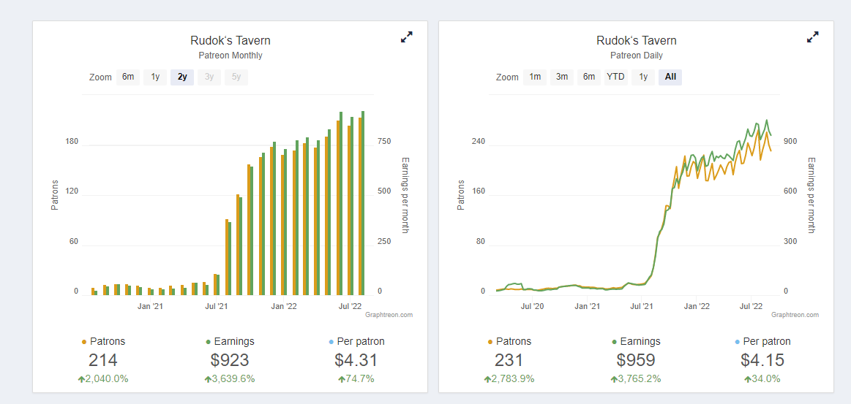

Slide 13
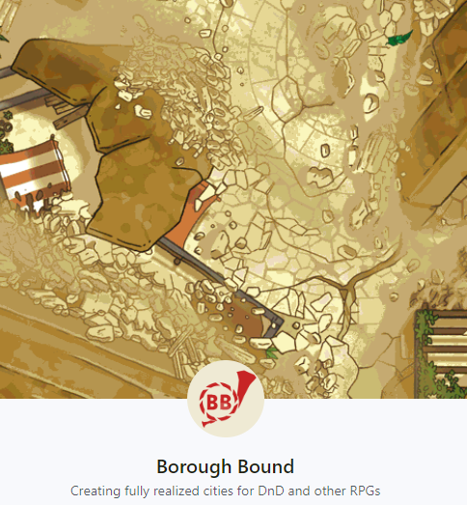
Delivery Kid ($3/Creation)
Hi-res and hi-quality battlemaps of each release
Monthly borough guides that'll help you get started GMing each city
Discord access! Come join our server for RPG chat and finding RPG games to be a part of.
General Messenger ($6/Creation)
All previous rewards
Weekly borough guides that provide everything you need to GM each city
Unique battlemap variants to radically change the way your players experience our worlds
Tailor-made music for each release to help you score your sessions
Chief Courier ($10/Creation)
All previous rewards
Distinct variants of each music track for even more sonic variety
Fully-furnished interiors for all of our battlemaps
Foundry VTT-ready versions of all our content
Postmaster General ($20/Creation)
Absolutely everything else we included in the previous tiers
A special thanks in any physical books that we print
Our never-ending appreciation for your support!
I wanted to share this one because it is very unique

Slide 14
Tier No.1 ($3/Month)
Monthly Encounter
Each Encounter features the following:
Custom Monster Stat Blocks
Monster Lore
Encounter Map & Instructions
PDF Compendiums of previous Items, Stat Blocks, and Spells
Early Access to Releases
Voting Rights on Future Releases
Tier No.2 ($5/Month)
Monthly Adventures or DM Supplements

Slide 15
Long Term Strategy
Continue to Build Following
Prepare to launch a Kickstarter
Outline what we would want in a Sea-Based Kickstarter. What Art Resources, Writing resources, etc would we need?
It looks like a lot of Kick-starters try to finish fulfillment within 6-12months of kick-starter end.

